Slide 1

Interactive Light and Sound Display with Arduino Synchronizing the magic of music and light
Nikola Momchilov

Slide 2
Table of Contents
Table of Contents
Introduction ........................................................................3
Components and Tools ..................................................... 4
Conceptualizing the Experience .......................................... 5
Implementation Highlights ................................................. 6
Looking Forward ................................................................. 7
Conclusion .......................................................................... 8

Slide 3
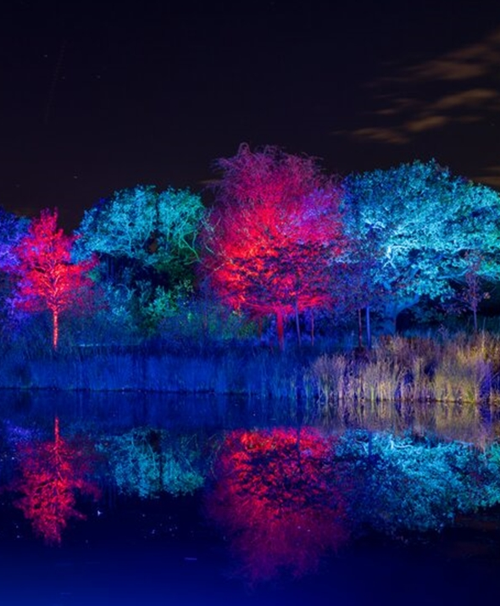
Introduction
Welcome to our GLOW Festival showcase, where we merge the enchantment of light and the allure of sound into an interactive journey through the park.
This prototype project invites visitors on a pathway of discovery, with each step unveiling a new sensory story inspired by nature and tales of the high seas.

Slide 4
Components and Tools
Arduino Uno
Arduino Uno, the brain orchestrating our symphony of sensors and lights.
RGB LEDs and LED
A trail of RGB LEDs and LED strips weaves alongside the path, ready to bathe the night in colour.
PIR motion sensors
PIR motion sensors stand guard, awaiting the approach of adventurers to awaken the scene.
Piezo buzzers and speakers
Piezo buzzers and speakers lie in wait, eager to fill the air with thematic scores at each sensor's cue.

Slide 5
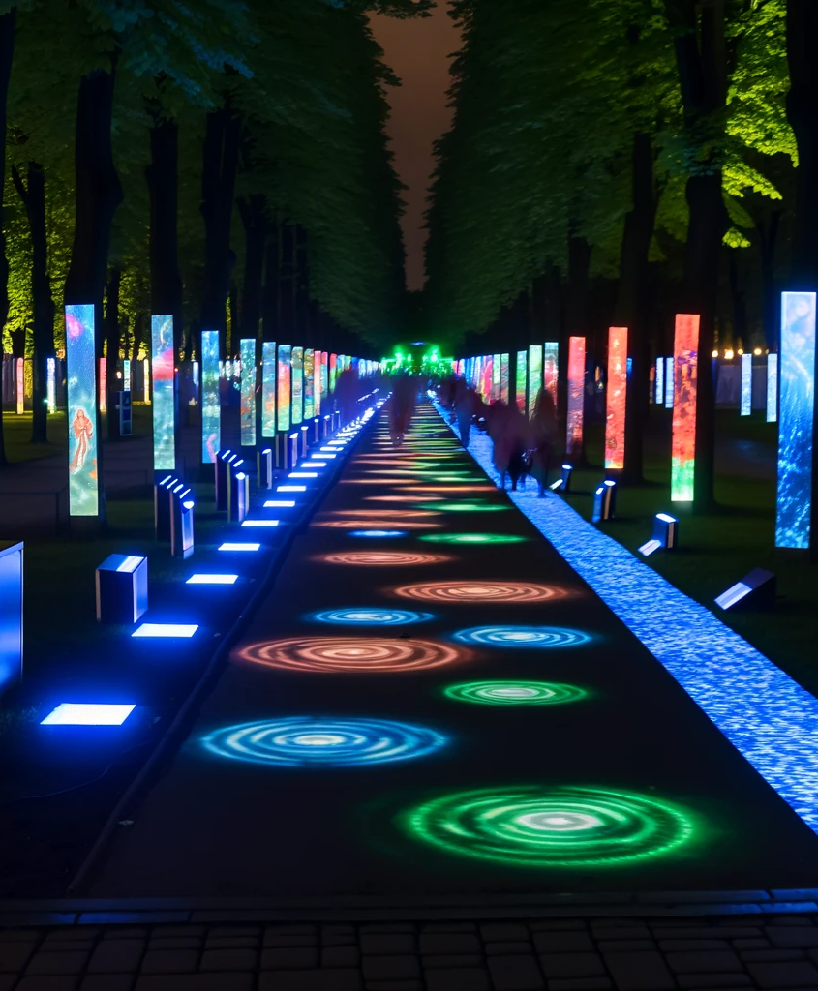
Conceptualizing the Experience
Design: Pathway segments themed around natural elements and natural adventures, using colour and sound for immersive storytelling.
Interaction: Motion sensors detect visitors, activating thematic lights and sounds for a captivating experience.

Slide 6
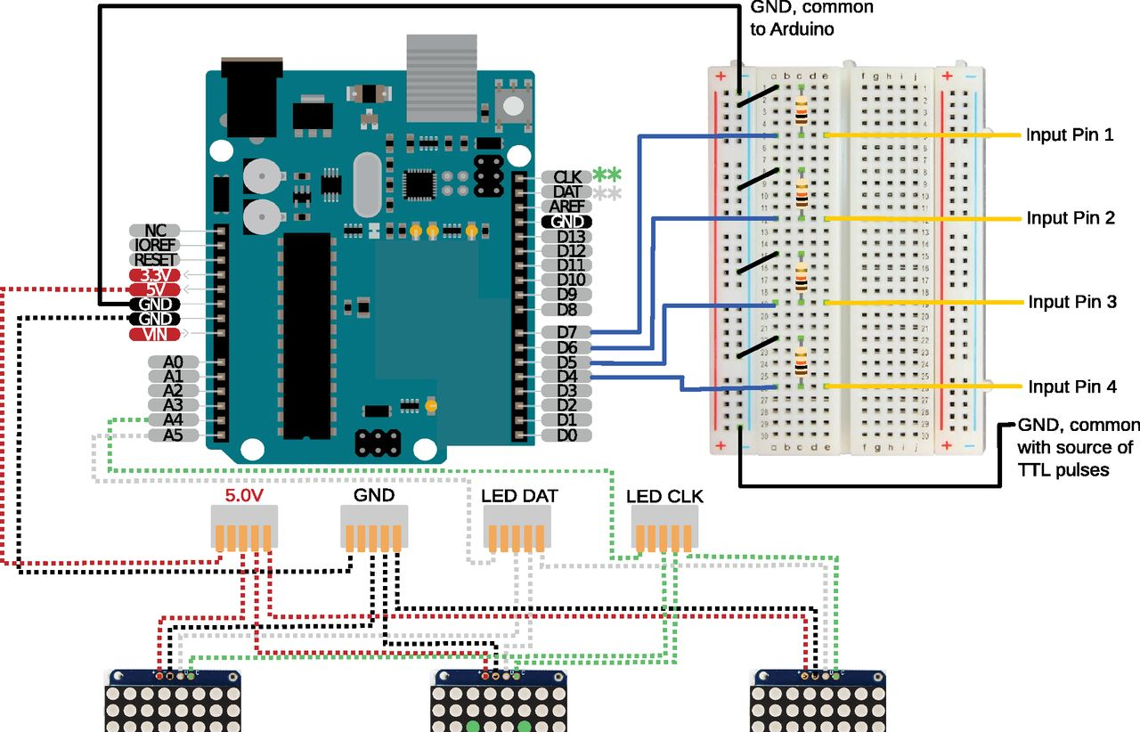
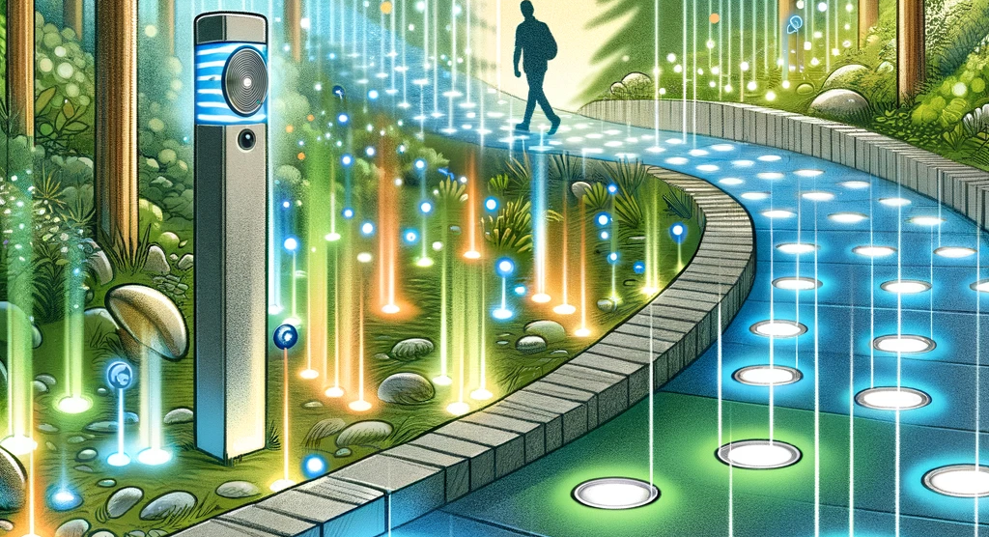
Implementation Highlights
Setup: Each motion sensor controls a pathway section, blending LEDs and sounds for thematic representation.
Programming: Arduino scripts synchronize sensory outputs, creating dynamic visual and auditory effects based on ambient conditions.

Slide 7
Looking Forward
Enhancements: Expanding themes, refining interactivity, and exploring advanced sensory integration for future iterations.
Vision: Elevating the GLOW Festival experience, setting a new standard for interactive installations.

Slide 8

Conclusion
Summary: The prototype project showcases the fusion of technology with natural and narrative elements, offering a new way to experience the park during the GLOW Festival.
Invitation: Feedback is welcome and ideas to enrich this journey further.

Slide 9

Thank you!

